Slide 1

VERBS RAP SONG
LAURA ROJAS PÉREZ
JULIANA CAÑAS ORTEGA
LUISA LOTERO ESCOBAR
MILENA ESPEJO GONZÁLEZ
12ºA

Slide 2

FIRST PART

Slide 3
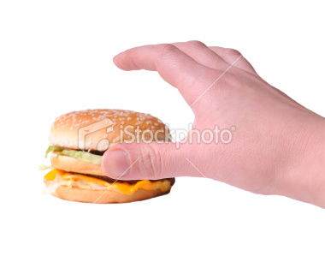



Take
Shake
Wake
Think

Slide 4

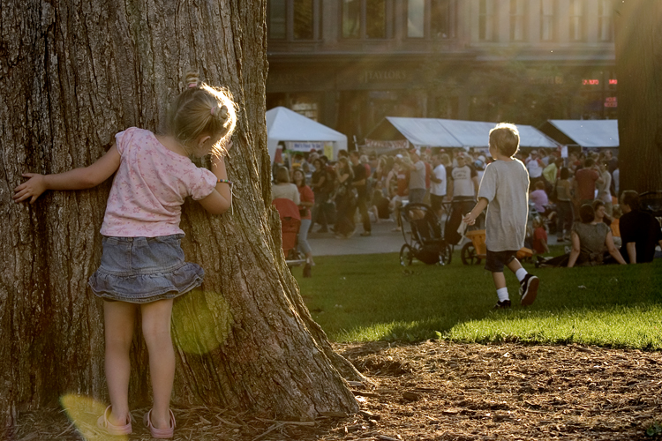

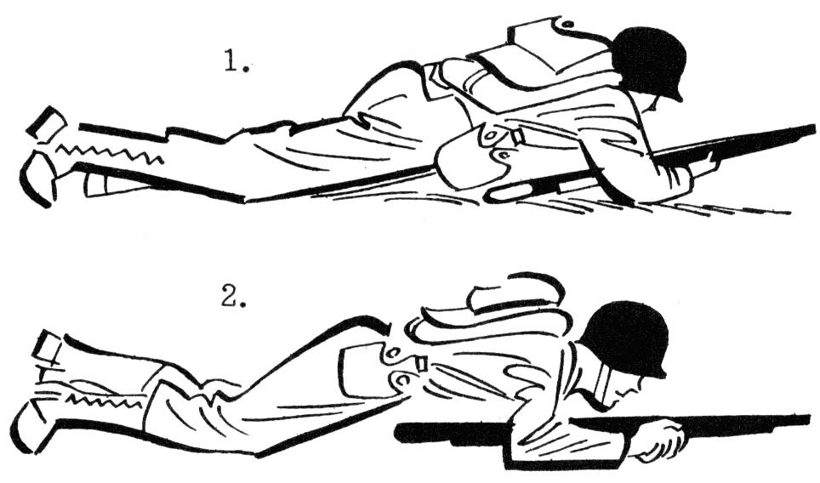
Seek
Teach
Sleep
Creep

Slide 5
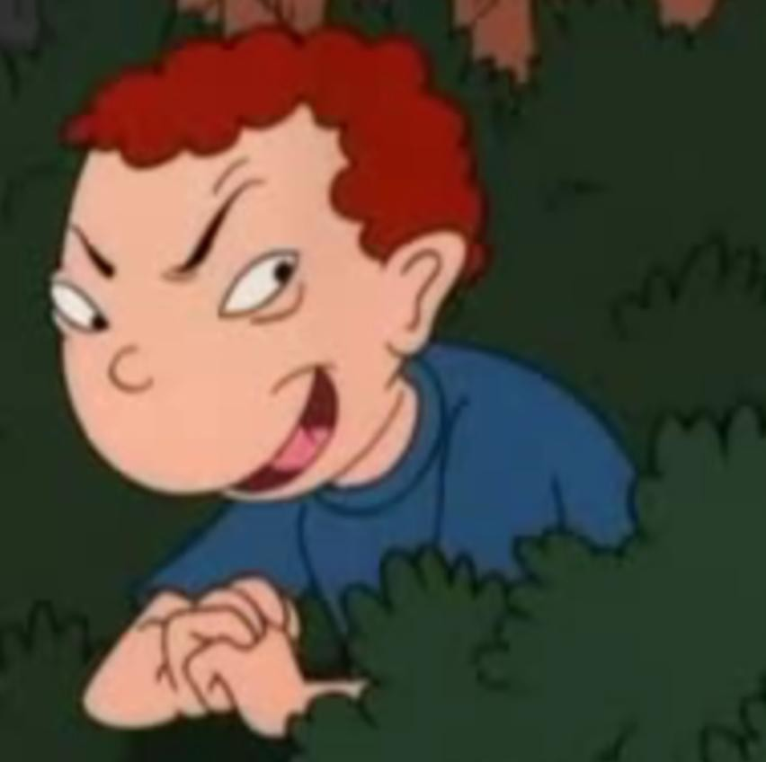



Sneak
Leap
Keep
Beat

Slide 6

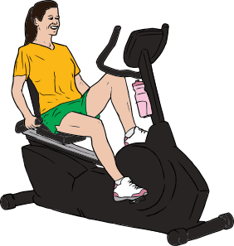


Win
Do
Begin
Shoot

Slide 7
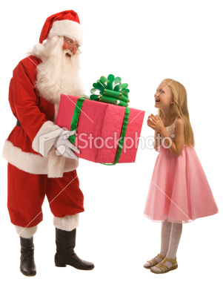

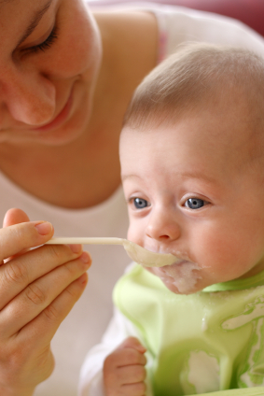
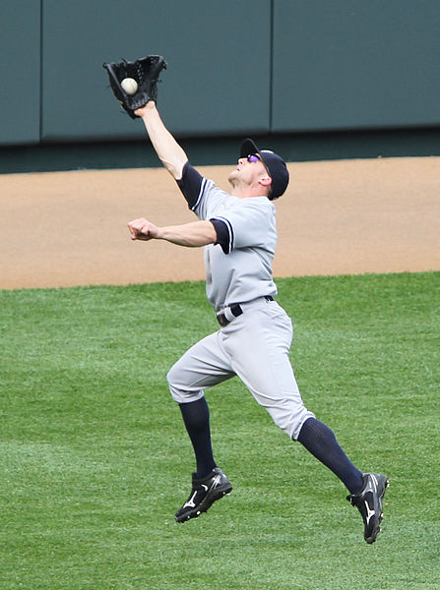
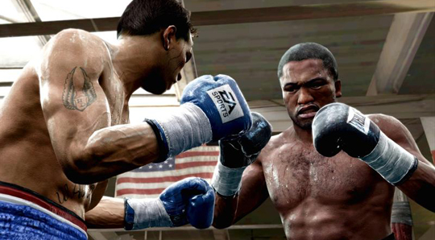
Lead
Feed
Bring
Catch
Fight

Slide 8

SECOND PART

Slide 9




Freeze Speak
Steal Choose

Slide 10
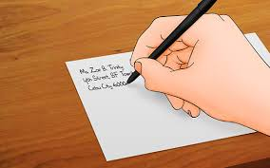

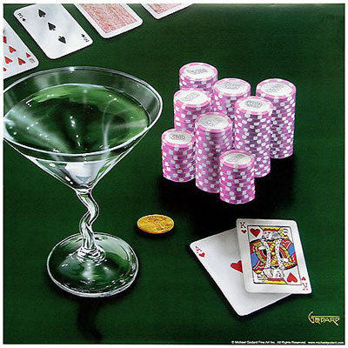

Write Meet
Bet Forget

Slide 11

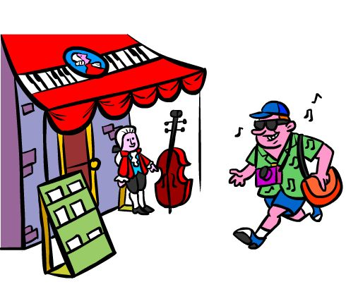

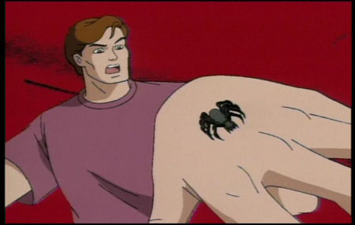
Get Come
Sing Sting

Slide 12
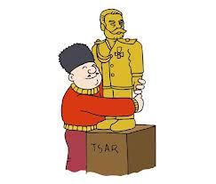
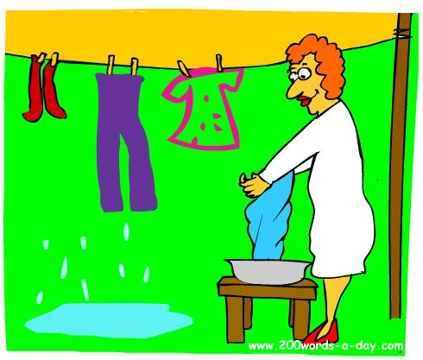
Cling
Hang

Slide 13

THIRD PART

Slide 14

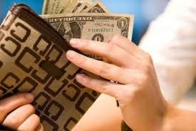


Dream Spend
Lend Lay

Slide 15



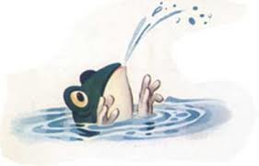
Make Stink
Drink Sink

Slide 16


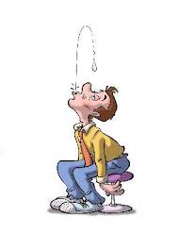
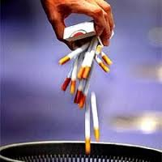
Hear Give
Spit Quit

Slide 17


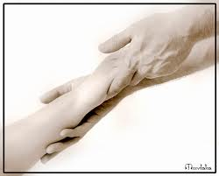
Sit Kneel
Feel

Slide 18

FOURTH PART

Slide 19

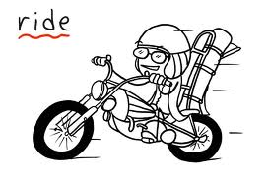


Rise Ride
Drive Hide

Slide 20

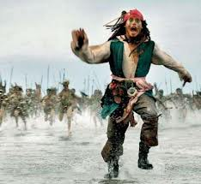
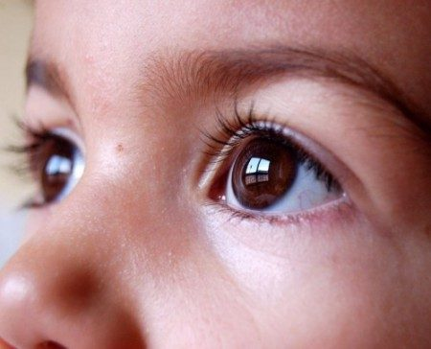

Find Flee
See Mean

Slide 21

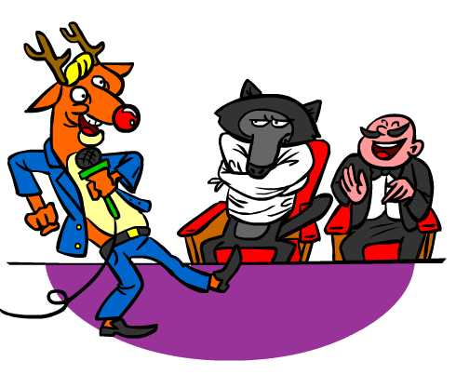
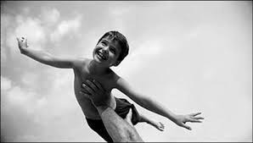

Send Show
Fly Know

Slide 22


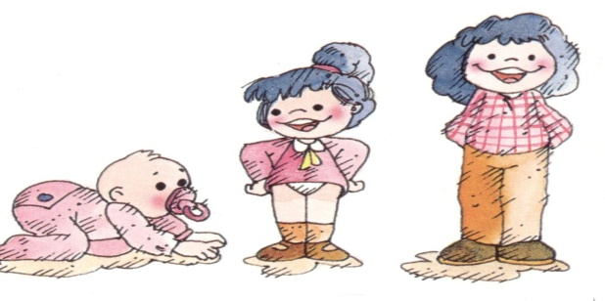

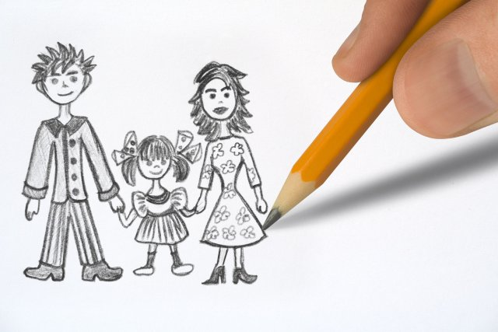
Shine Throw
Grow
Draw Go

